Slide 1
Chapter 11 – Pointer Variables
Reading Assignment: Chapter 11 in Introduction to Programming with C++, 3rd Edition, by Liang.
Before introducing pointer variables, a little background in memory addresses, binary numbers, and hexadecimals numbers is helpful.
Memory addresses
Up to this point, we have not been concerned with memory addresses, but each variable is stored in your computer at a certain address and uses a certain number of bytes of memory depending upon the type (int - 4 bytes, double - 8 bytes, etc).
Example: The values of variables A and B below might be stored at the addresses indicated (the compiler determines which addresses to use based on what memory address are free in your computer.)
int A = 3, B = 18;
Memory Address | Value stored in memory
FFB0 | 3 (or 0000000000000011₂)
FFB2 | 18 (or 0000000000010010₂)
Notes:
1

Slide 2
Number systems
Computers are binary machines and work with binary numbers (base 2). In most cases, compilers or other programs allow us to work with base 10 numbers, instructions, etc, and conversion to and from base 2 takes place without our involvement. However, sometimes it is helpful to understand how the computer really works.
Decimal numbers (base 10)
10 unique digits: 0, 1, 2, 3, 4, 5, 6, 7, 8, 9
Place values of 10^{N} (1, 10, 100, 1000, etc)
Counting sequence (when run out of digits: carry and start over)
Illustrate
Expanding by place value
Example: 2547₁₀
Notes:
2
2

Slide 3
Binary numbers (base 2)
2 unique digits: 0, 1 (note: binary digit = “bit”)
Place values of 2^{N} (1, 2, 4, 8, 16, 32, 64, 128, etc)
Counting sequence (when run out of digits: carry and start over)
Illustrate
Memory is organized in bytes (groups of 8 bits) with 1 memory address for each byte.
Expanding by place value
Example: 00110111₂
Large binary numbers
Computers might use 16, 32, or 64 bit addresses (or more) and it becomes difficult to work with so many 0’s and 1’s. The following 32-bit address is awkward to work with:
00110101111000100111010001100101
What is a better method? To work with hexadecimal numbers.
Notes:
3
3

Slide 4
Hexadecimal numbers (base 16)
16 unique digits: 0, 1, 2, 3, 4, 5, 6, 7, 8, 9, A, B, C, D, E, F (where A =10, B = 11, C = 12, D = 13, E = 14, F = 15)
Place values of 16^{N} (1, 16, 256, 4096, etc)
Our key interest here is showing that one hexadecimal digit can be used to represent 4 binary digits (bits). This is illustrated in the table shown. Advantage? Less digits to work with!
To convert from hexadecimal to binary, replace each digit by the binary equivalent.
To convert from binary to hexadecimal, replace each group of 4 bits (starting on the right) with the hexadecimal equivalent.
Hexadecimal Digit | Group of 4 bits
0 | 0000
1 | 0001
2 | 0010
3 | 0011
4 | 0100
5 | 0101
6 | 0110
7 | 0111
8 | 1000
9 | 1001
A | 1010
B | 1011
C | 1100
D | 1101
E | 1110
F | 1111
Notes:
4
4

Slide 5
Hexadecimal and binary numbers
Example: Convert A7F8 to binary
Example: Convert 1110010100011100 to hexadecimal
Example: If A,B,C, and D are stored consecutively in memory with A at memory address FFA0, list the memory addresses for B, C, and D.
int A = 3, B = 18; // assume 4 bytes per variable
double C = 2.5, D = 3.5; // assume 8 bytes per variable
Variable | Memory Address | Value stored (decimal)
A | F3A0 | 3
B |  | 18
C |  | 2.5
D |  | 3.5
Notes:
5
5

Slide 6
Chapter 11 – Pointer Variables
Pointer variables, or pointers, are variables that store memory addresses rather than values of variables.
Why use pointers?
Pointers allow a C++ program to perform low-level operations (working with addresses, registers, ports, etc) and give the programmer more control. Specifically, using pointers will allow the user to (some topics listed are advanced and will be covered in later programming courses):
Reserve memory during program execution (Dynamic Memory Allocation) – included in this presentation
Create data structures (queues, stacks, linked-lists, etc.) – later course
Efficiently link classes and objects – later course
We will cover basic pointer applications as well as Dynamic Memory Allocation in this course.
Notes:
6
6

Slide 7
Declaring pointer variables
A pointer variable is declared much like other variables, except that an * must precede its name.
Example:
int *Pointer1, *JPtr, *Address_of_x; // pointers
double *NPointer, *MPoint; // pointers
Notes:
Pointers contain the address of another variable
It is common to use a name that includes Ptr, address, pointer, etc., as a reminder.
The asterisk can be anywhere between the type and the identifier.
Example:
int *APtr;
int* BPtr;
The address of a variable is assigned to a pointer variable using the address-of operator (&). See next slide.
Notes:
7
7

Slide 8
Address-of Operator (&)
The address-of operator (&) is used to assign the address of a specific variable to a pointer variable. Note that the variable and its pointer must be of the same type.
Example:
int A = 33; // declare and initialize A
int *Aptr = &A; // declare and initialize Aptr
or the following example is equivalent to the one above
Example:
int A; // declare A
A = 33; // initialize A
int *Aptr; // declare and initialize Aptr
Aptr = &A; // initialize Aptr (note that the * is only
// needed when declaring the pointer)
Notes:
8
8

Slide 9
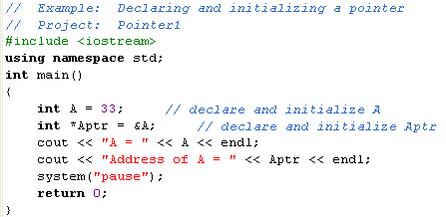
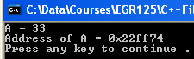
Example:
The example on the previous slide was executed below. Note that the address for Aptr will probably be different for each computer. What is the address in binary? Binary address = _________________________
Notes:
9
9

Slide 10
More on the Address-of Operator (&)
Notes:
The address-of operator (&) can be used without declaring a pointer variable.
Example:
int A = 33;
cout << “The address of A = “ << &A << endl;
The pointer must be of the same type as the variable to whose address it points (or a compiler error will be generated).
Example:
int A;
double B;
int *Aptr, *Bptr;
Aptr = &A; // OK: int pointer points to int variable
Bptr = &B; // Error: int pointer points to double variable
Notes:
10
10

Slide 11
Value stored at the address contained in a pointer
The unary operator (*), sometimes called indirection, is used to indicate the value stored at the address contained in a pointer.
Form: *PointerVariable //value stored at address in pointer
Example:
int A = 33;
int *Aptr = &A; // pointer containing address where A is stored
cout << “Value of A is “ << *Aptr << endl;
Example:
double x = 2.5, y = 3.8, z = 6.7;
double *xptr = &x, *yptr = &y, *zptr = &z;
y = *xptr; // changes y to 2.5
*yptr = z; // changes y to 6.7
Notes:
11
11

Slide 12
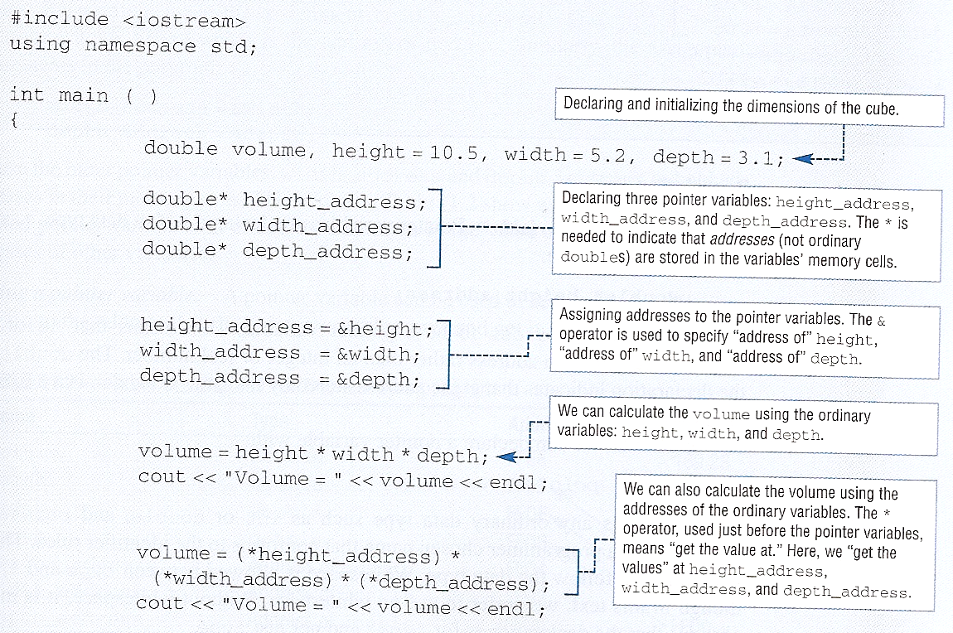
Text example - discuss
Notes:
12
12

Slide 13
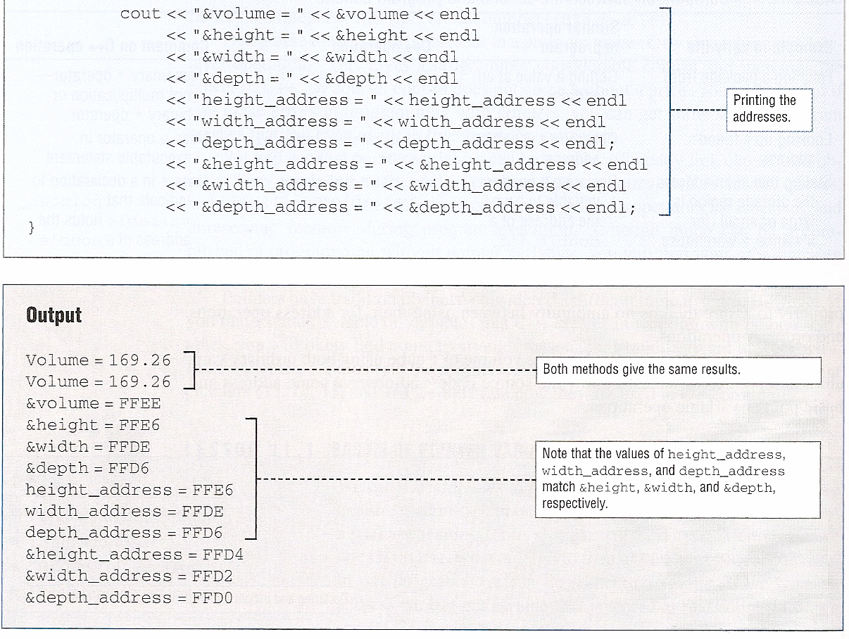
Text example - discuss
Notes:
13
13

Slide 14
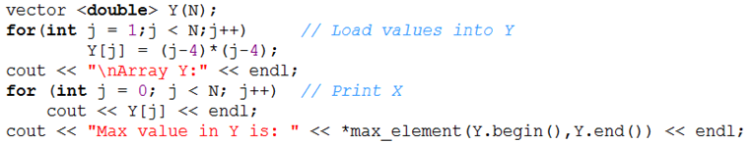
Iterators
Iterators are similar to pointers. A pointer is a type of iterator, but an iterator is more general. Iterators can be used to access data in other types of containers. For students continuing in computer engineering, later courses in C++ will explore the differences.
When we used the vector class in Ch 12 we used the following functions:
max_element(name.begin(), name.end()); //returns the position (iterator) of the max value in the vector
max_element(name.begin(), name.end()); //returns the position (iterator) of the max value in the vector
Since the functions return an iterator, the indirection (*) operator is used to access the value pointed to by the iterator. Example: (from Ch. 12 notes)
indirection
Notes:
14
14

Slide 15
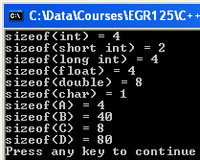
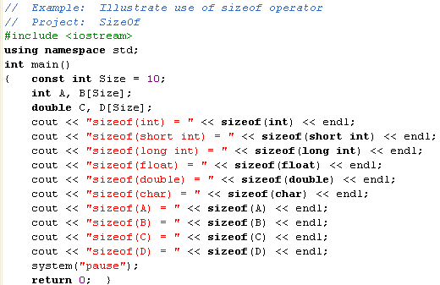
sizeof operator
The sizeof operator is an easy-to-use function that will return the number of bytes used by your computer to store a given type, variable, or array.
Form: sizeof (type, variable, or array)
Notes:
15
15

Slide 16
Incrementing and decrementing pointers
Form: PointerVariable++ // increments PointerVariable (an address)
// by the sizeof the corresponding type
Form: PointerVariable-- // decrements PointerVariable (an address)
// by the sizeof the corresponding type
Pointers and arrays
Using the name of an array without brackets refers to the starting address of the array.
Example:
int A[10],B[10];
int *Aptr = &A[0]; // Aptr contains starting address of array A
int *Bptr = B; // Bptr contains starting address of array B
Recall that it isn’t necessary to use an & when passing arrays as arguments in functions to make them reference parameters. This is because the function call actually passes the starting address of the array.
Example: Function2(A, B, Size); //pass arrays A & B to function
Function2(&A[0], &B[0], Size); // same as above!
Notes:
16
16

Slide 17
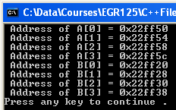
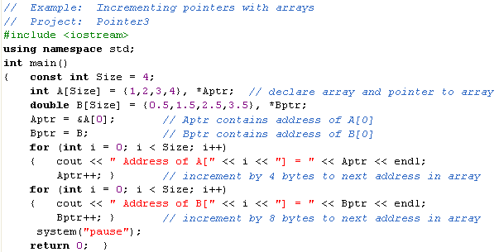
Example: Pointers and arrays
Discuss the program below. Note by how much each address is incremented.
Notes:
17
17

Slide 18
Dynamic Memory Allocation
In all examples so far using arrays, we have had to specify the size of the
array in the program (as a constant) and the compiler would allocate
memory to store the variables before running the program.
Pointers can be used to implement dynamic memory allocation
(or run-time allocation), where the size of the array is determined
and memory is allocated during program execution.
This allows programs which do not:
1) waste memory by specifying a large maximum array size
2) need to be modified in order to handle larger arrays than their current dimensions allow
Run-time allocation of arrays requires the use of pointers and
the new command.
Notes:
18
18

Slide 19
“new” command
Used to allocate new memory during program execution.
Form: new type or new type[Size];
Notes:
Size does not need to be a constant (as is normally the case with arrays)
The new command returns the address of the beginning a block of memory
Returns 0 (null address) if not enough memory available
The new variable or array has no name, but can be referred to using a pointer.
Example – allocate new single variable during program:
int *ValuePointer;
ValuePointer = new int; // allocate memory for 1 new variable
*ValuePointer = 3;
No name!
ValuePointer
Address
Address:
3
Notes:
19
19

Slide 20
“new” command (continued)
Example – allocate new array during program:
int *ArrayPointer;
ArrayPointer = new int[8]; // Allocate memory for an array
ArrayPointer[0] = 3; // Use the pointer to refer to array elements
ArrayPointer[1] = 4;
ArrayPointer[2] = 5;
Address:
3
4
5
Array has
no name!
ArrayPointer
Address
“delete” command
Used to release previously allocated memory.
Form: delete [ ] ArrayPtr //array
or delete ValuePtr //single variable
Example (delete new memory in example above)
delete [] ArrayPointer;
Notes:
20
20

Slide 21
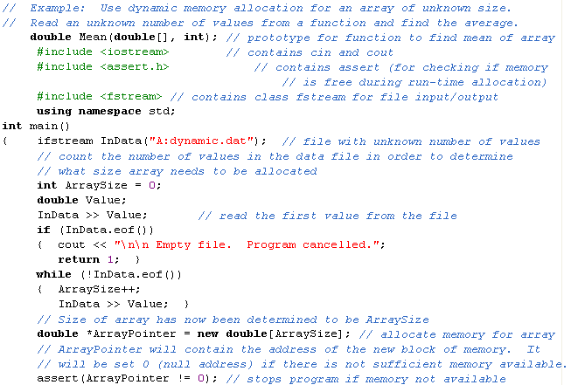
Example: Dynamic Memory Allocation
Notes:
21
21

Slide 22
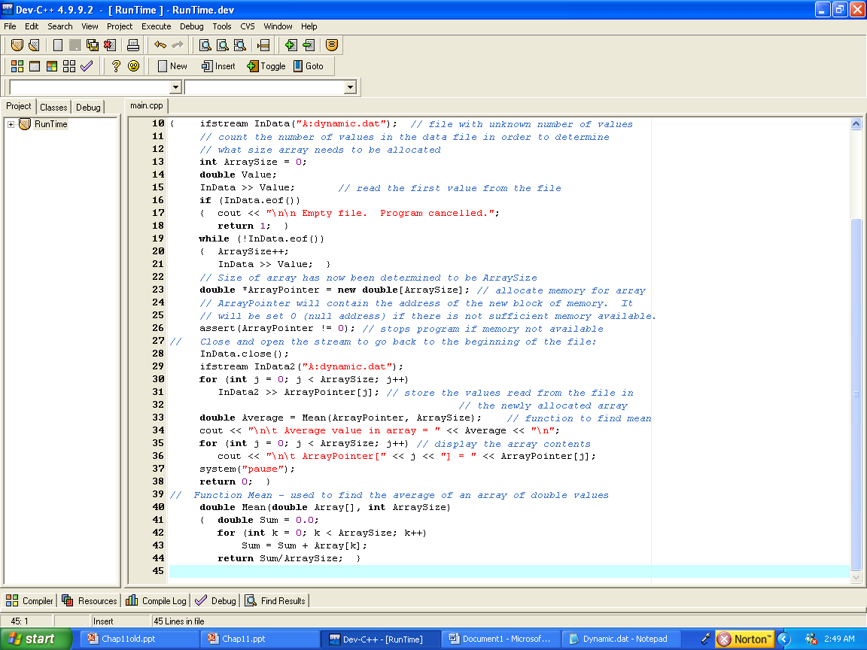
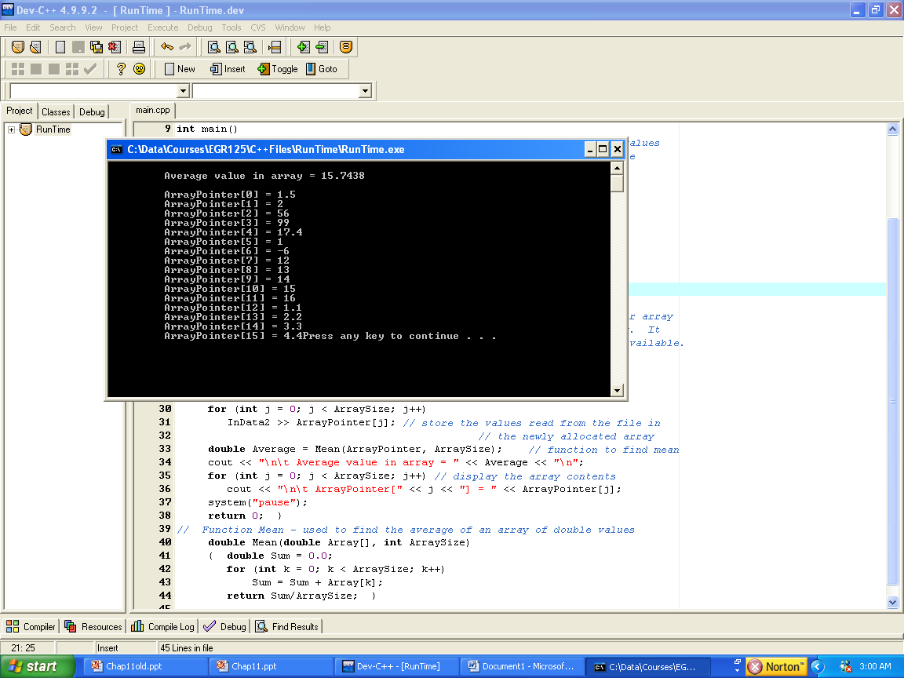
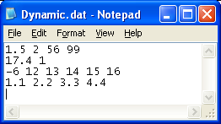
Notes:
22
22

